Slide 1
Template presentation
11-11-2018

Slide 2
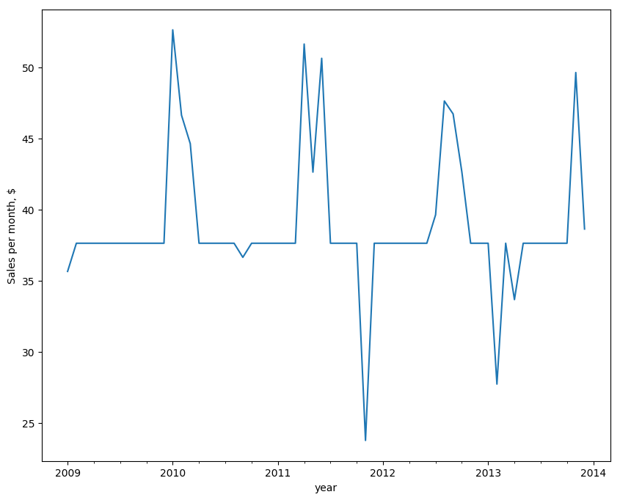
Total company sales by month
%%Placeholder%%

Slide 3
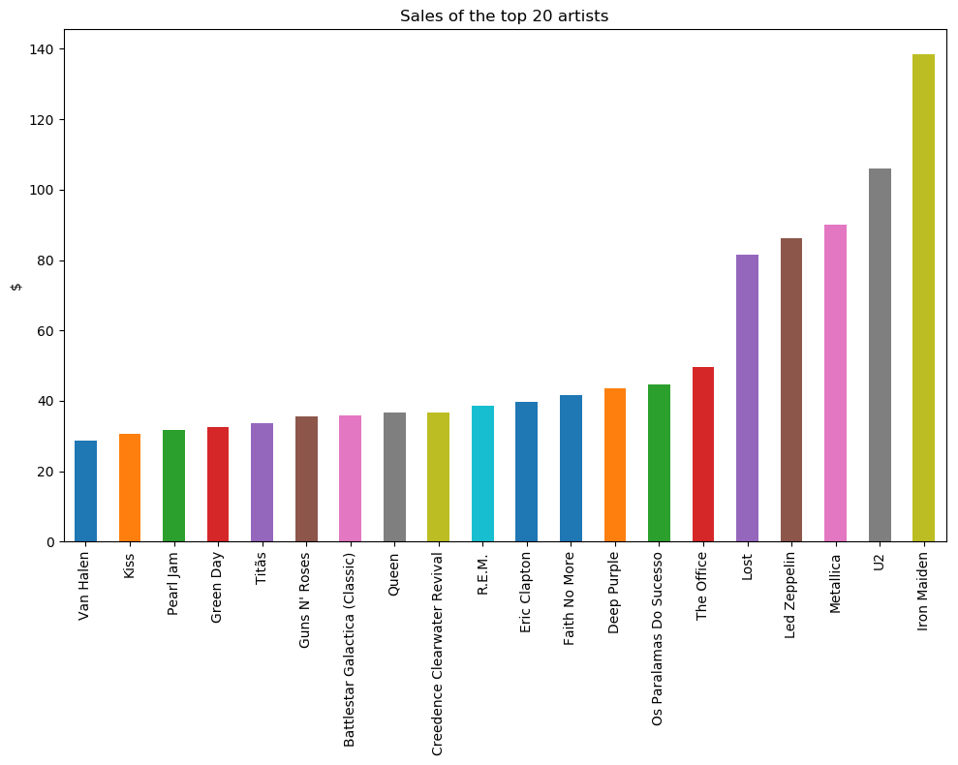
Sales of the top (by sales) 20 artists

Slide 4
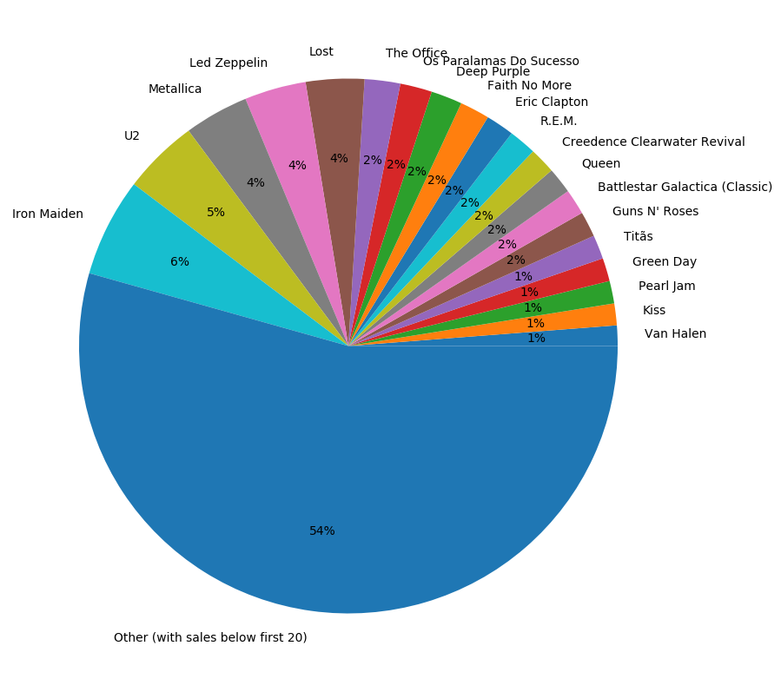
Proportion of sales by artists

Slide 5
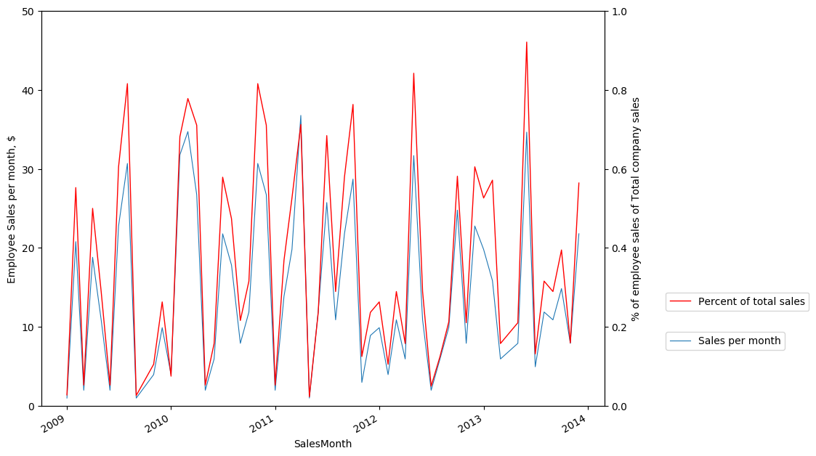
Employee details:Manoj Peacock

Slide 6
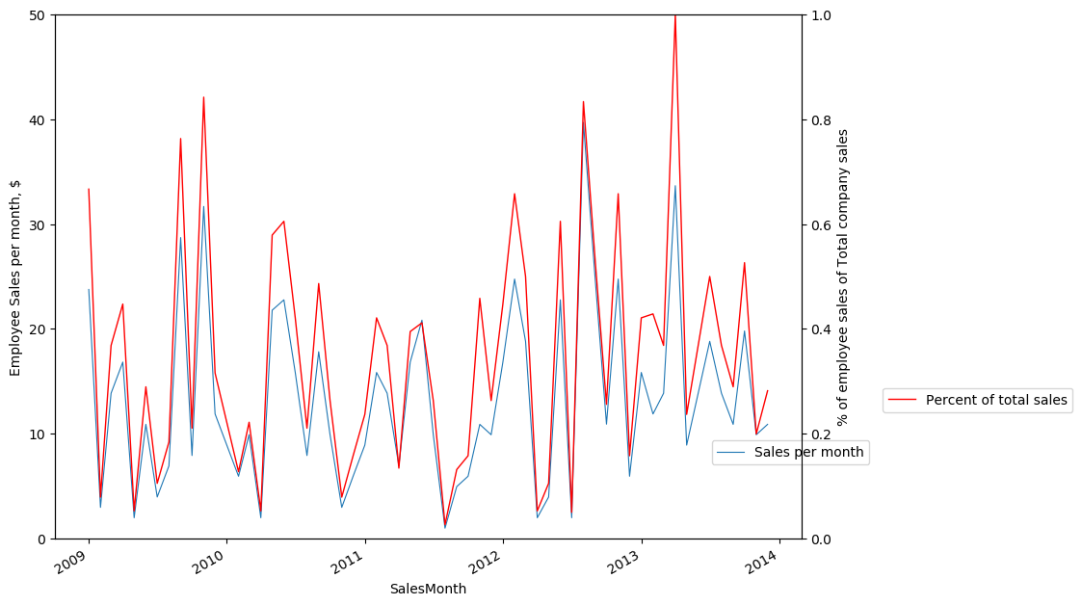
Employee details:Madalena Park

Slide 7
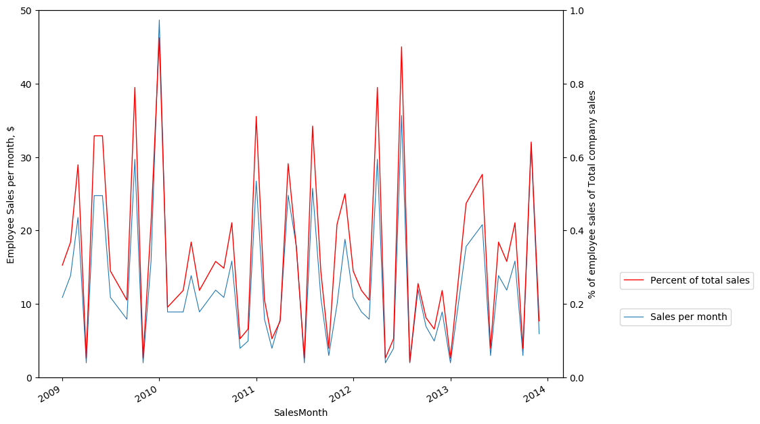
Employee details:Victor Johnson

